Slide 1
NCRS Judging Seminar
Northern CA Chapter Meet
Spring 2019

Slide 2
Disclaimer
Included tips and comments regarding NCRS operational judging (or the judging process in particular) are based on my own 20+ years experience judging Corvettes as a member of the NCRS. All questions or specific issues should be appropriately addressed to the proper authority, including Chapter Judging Chairpersons, Team Leaders and the National Judging Chairman. My comments may/may not reflect their opinions and are meant to guide and assist development of your judging technique and experiences only.
Bob G

Slide 3
NCRS Flight Judging
Cars are to be judged to the standard of vehicle appearance and as equipped at the time and point of final assembly by the Chevrolet Motor Division of General Motors Corporation. “Presentation for judging is to be in the condition normally associated with that of a Corvette which has undergone the then-current standard Chevrolet Dealer New Car Preparation for delivery to a purchaser, exclusive of any dealer or purchaser inspired additions, deletions or changes”

Slide 4
Judging Purpose
Flight Judging purpose is to evaluate the NCRS standard using a Matrix System.
Originality
Exterior, Interior, Mechanical, Chassis, Operations
Condition
The extent to which the components, assemblies and areas have sustained deterioration or damage.
Cleanliness
The overall cleanliness of the car as presented for judging
Flight Judging is subjective. The judgment and opinion of fellow NCRS members

Slide 5
Judging Matrix
The NCRS Judging Matrix is an assessment of four distinct categories:
Operations- Function of the component vs. agreed standard
Originality- Consistent with factory configuration, installation, date, configuration, and-or finish
Condition –wear or damage assessment
Cleanliness – accumulation of dirt other than as delivered

Slide 6
Operations Evaluation
NCRS Flight Judging evaluates the functionality of key components for each 1953-200x Corvette as presented on the judging field.
These evaluations are conducted on stationary vehicles in a step-by-step process outlined in each vehicle’s specific NCRS Judging Reference Manual.
Additional and year specific Operations Guidance may be found in the April 2018 Judging School PPT Presentation.
720, 740 or 750 points value out of 4500 (16%)

Slide 7
Originality Evaluation
NCRS adopted the CDCIF matrix to determine the apparent originality of components, assemblies and areas presented for the flight judging award process. Each component is evaluated for the following attributes against best known factory production data, assembly processes and engineering standards. This data is continually reviewed, updated and republished.
Completeness
Date
Configuration
Installation
Finish

Slide 8
Originality Evaluation
Each component evaluated under the CDCIF metric is given equal weight per metric. If all 5 metrics are present, or should be, each is equally weighted at 20% of the prescribed originality points allocated. If less than 5 metrics are expected, the weighting is distributed equally across those metrics (ex. 4 @ 25%).
Scoring is recorded in the Originality section of the scoring sheet, per component.
All NCRS scoring is based on a deduction of points process to reflect the team judges evaluation of the component versus the standard.

Slide 9
Original vs. Restored
Original- Present or existing from the beginning; first or earliest
Original-Something serving as a model or basis for imitations or copies
Original- the first one made and not a copy
Restore- Bring back or reinstate
Restore- Return to a former condition, place or position
Restore- Repair or renovate (a building, work of art, vehicle, etc…) so as to return it to original condition (2019, Cambridge, Merriam-Webster)

Slide 10
Originality vs. Restored }CDCIF
A component that meets all criteria when evaluated using the CDCIF metric has by definition achieved the “original condition” dictionary standard and can be considered original equipment.
A component that does not meet all criteria evaluated using the CDCIF metric by definition no longer meets the same dictionary standard of original equipment.

Slide 11
NOS vs. NORS
NOS- New Old Stock (New On Shelf/New off shelf): Obsolete components or original parts that have never been sold at retail. Includes GM and their divisions new, unsold parts.
NORS- New Old Replacement Stock: Components produced by a third party that were solely meant to substitute for original or NOS parts. Includes replacement parts made by or badged as by someone other than the vehicles original manufacturer. Includes any 3rd party manufacturer, licensed by GM to produce the part or not.

Slide 12
CDCIF- Date
Dating means either the actual dating coded to the component by the manufacturer
Implied dating – the logical sequence of manufacturer observed for the component in comparisons to the actual build date of the vehicle.
Implied dating may no longer be subjectively deducted. NCRS acknowledges that many reproduction components that were obviously not produced at the time of vehicle assembly (GM Supply Sourcing Intervals) are produced by our partners using a service restoration intent. NCRS does not wish to penalize our manufacturing partners for implied date.
CDCIF is applied to evaluate the originality of the component.

Slide 13
“Significantly Dissimilar”
A new concept has been introduced at the 2019 Judging Retreat held at Dallas, Texas. “Significantly Dissimilar” describes a component installed on the vehicle that fails to meet four of the five** CDCIF criteria in the opinion of the flight judges in comparison to the typical factory installed component. The result would be a full deduction of originality (and subsequently) condition points.
Does not apply to those components covered in the 8th ed. Judging Reference Manual under Standard Deductions.
**Note: the 4/5 test is my own standard to apply this concept. (Installation may also fail). Further guidance is required from our National Team leaders.

Slide 14
“Significantly Dissimilar”
Example 1: An aftermarket carburetor (ex. Edelbrock) would fail configuration, date, completeness and finish and be identified as “significantly dissimilar”.
Example 2: Aftermarket distributor that fails configuration, date, completeness and finish.
Example 3: Aftermarket radiator that fails C,D,C & F.
Example 4: Napa Fuel Pump that fails C,D,C & F.
Just because a component is installed, does not automatically earn points for originality or condition.

Slide 15
“Significantly Dissimilar”
Flight Operations evaluation: Components found to be significantly dissimilar require a 100% deduction for functionality in the Flight Operations Evaluation.
Ex. An aftermarket Bluetooth Type CD Radio that fails C,D,C and F in a car that was not factory equipped.
Ex. Aftermarket Air Conditioning System

Slide 16
10% Rule
The judges originality assessment of the component, assembly or area must score a minimum of 10% of the available originality points in order to award condition points
This is the single relationship that exists between Originality and Condition assessments by the judges. No other relationship exists.

Slide 17
Condition Evaluation
Condition assessments of a component, assembly or area are generally judged without regard to originality except;
10% Rule
Missing parts

Slide 18
Condition Scoring
Categorizing a component, assembly or area’s apparent condition is simplified by applying a quartile level of measure ( 3 M’s);
No damage or decay- 0% deduction
Minor Damage or decay- 25-50% deduction
Moderate damage or decay- 50-75% deduction
Major damage of decay- 75-100% deduction

Slide 19
Condition Scoring
Determine the percentage of deterioration from factory expectation:
Factory expectation – No deduction warranted
Multiply X .25 = Component presents minor wear or aging.
Multiple X .50 = Component presents moderate wear or aging. Rust, scale, surface damage are evident.
Multiply X .75 = Component presents significant wear or aging. Rust, scale, surface damage are evident and have damaged the original component. Portions may be missing, Rust has decayed the original surface layer(s) of the component.
Multiply by 1.0 = Component presents extreme wear or aging. Rust, scale, surface damage are evident > 75% of surface and have significantly damaged the original component. Portions may be missing, Rust or corrosion have decayed the original surface layer(s) of the component. Component can be replaced but can not be restored (Full Deduction)

Slide 20
Rust
Rust (iron oxide) occurs when iron or an alloy that contains iron (ex. steel) is exposed to oxygen and moisture over time. Only iron or alloys that contain iron can rust. Where rust is present, the component’s “condition” has been compromised and requires restoration to factory condition.

Slide 21
Corrosion
Corrosion is the natural process of converting a refined metal to an oxide, sulfide or hydroxide. It is the gradual destruction of metals by chemical or electrochemical reaction to the environment. Rust is an example of an electrochemical corrosion process.
Corrosion (degradation) can occur in non metals as well, including ceramics and polymers. Corrosion degrades the structure, strength, and appearance of the component. Aluminum is susceptible to galvanic corrosion by contact with dissimilar metals or a common electrolyte.

Slide 22
Pitting
Pitting results when a small cavity or hole forms in the metal. Pitting via corrosion occurs because the surface of the metal and the cavity have dissimilar ph levels caused by environmental conditions and galvanic reactions.

Slide 23
Decision Tree
@ Hand Out

Slide 24
Judging Retreat
Flight Operations Judging Guidance:
In each Corvette Technical Information Manual and Judging Guide (i.e. the judging manuals) there are specific guidelines for each operating function that are not necessarily listed on the judging sheet.
The Primary Function of the component must work in order for secondary functions to receive partial points.
Ex. Radio – Radio Function (Primary) includes power light and mechanical operations (buttons, sliders or knobs.
- Tone, Volume, fade, etc… (These are secondary functions of the radio component and their typical and intended function may also be specified in the manual)
Ex. Heater Defroster and A/C for 1968-1969 Ops
Vent Door Operations is integral to the acceptable function of the blower switch operation and varies between the two years (secondary)

Slide 25
Judging Retreat
If an R.P.O (Regular Production Option) was not available for the particular year of the judged car, the component receives a full deduction for operations, originality and condition and cannot be Performance Verification judged.

Slide 26
Judging Retreat - Paint
DOI (Distinctness of Image) and reflective qualities of the paint (orange peel) must be consistent front-to-back of the entire vehicle but NOT necessarily side-to-side due to human application inconsistencies.
Pin Striping – Any type and no matter how minimal = Full deduction of entire paint points.
1967 Hood Stinger – deduct 40% (Refer to non-typical configuration, completeness installation and finish).

Slide 27
Judging retreat
Altered Engine Stamp Pad – deduct stamp pad finish points for any owner or builder inspired stampings inconsistent with factory production stamp sets

Slide 28
Judging Retreat
Performance Enhancements – Full deduct
Ex. Quartz Clock
Ex. Wilwood Brake calipers
Ex. Poly bushings unless factory installed
Gas Shocks unless factory installed

Slide 29
DOI – Typical Diffusion

Slide 30
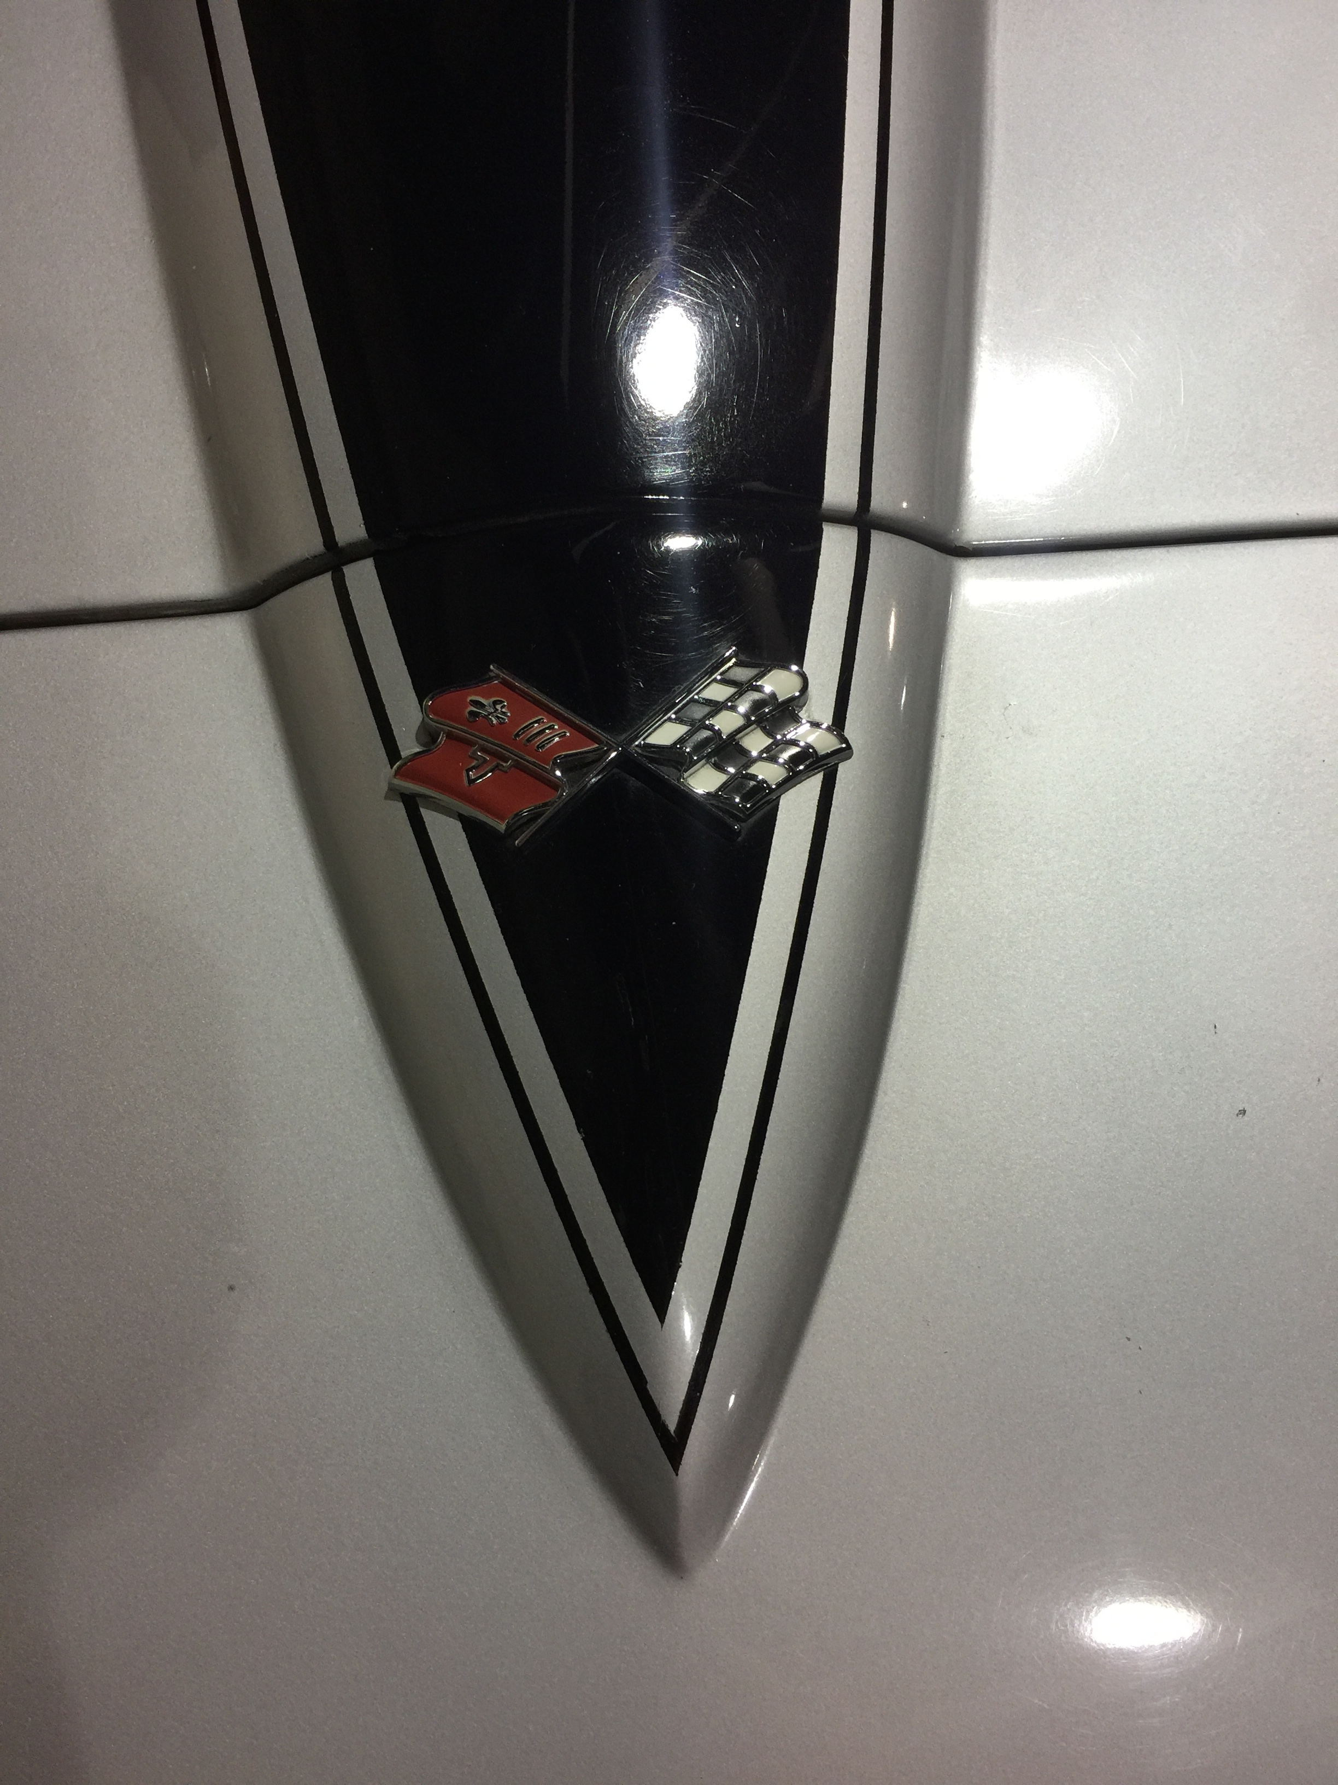
Non Typical vs. Typical -40%

Slide 31
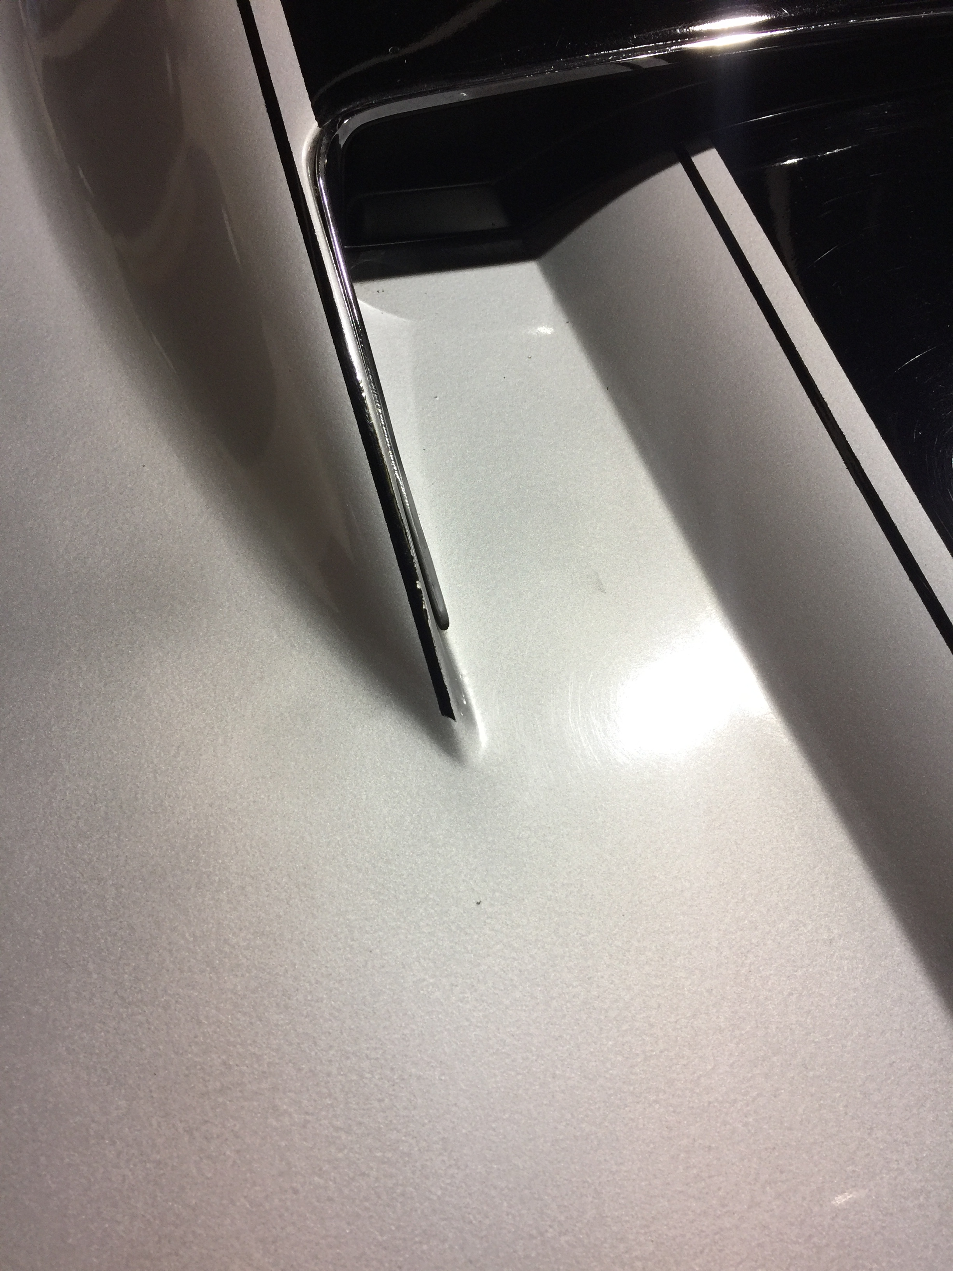
Not Typical vs. Typical -40%

Slide 32
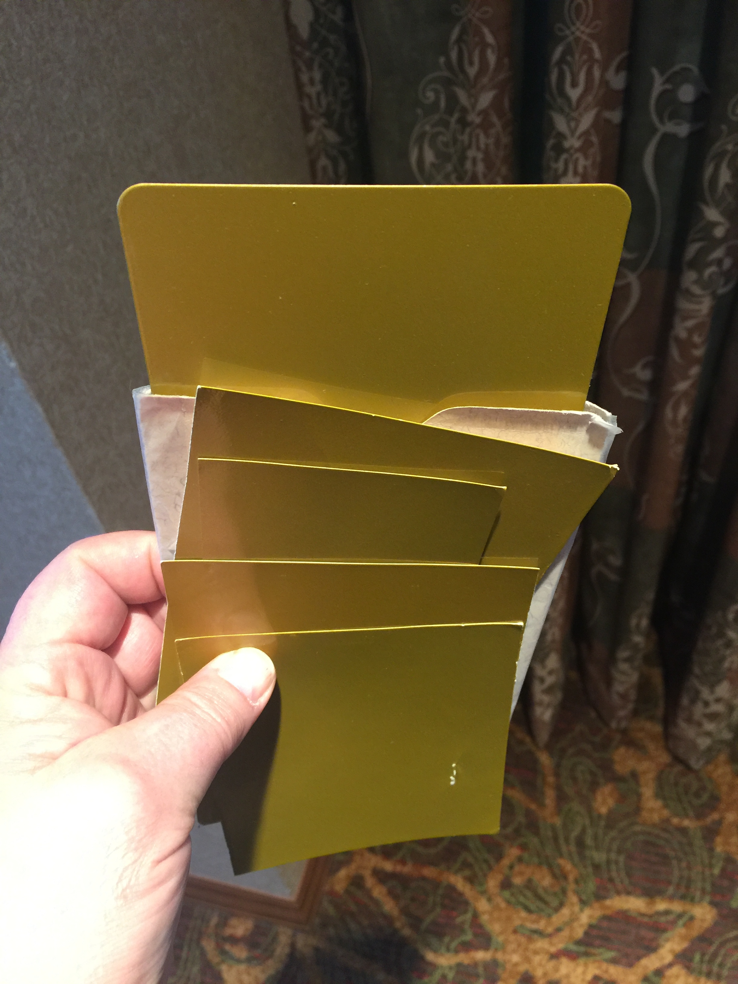
Paint Color Variation: 989 “War Bonnet Yellow ” Paint 1971-1972
Multiple DuPont mixes
(Example – Thanks to John Ballard)

Slide 33
Safe Ops & Etiquette
Do everything in your power to not damage the vehicle that you are judging.
Safety is paramount when judging operations. The vehicle will be running. It is your team’s responsibility to determine if the vehicle and its owner can operate the vehicle in a safe manner. If you have any concerns, voice them to the team leader before proceeding.
Check thoroughly for any leaks, especially fuel before beginning the Operations Judging process. Fuel leak of any type will STOP judging process. Seek instruction from Team Leader and Judging Chairpersons immediately.
Confirm a proper fire extinguisher is at the ready. A proper fire extinguisher has an “ABC” rating: A-paper, cloth, B- liquid, C- electrical components.

Slide 34
Safety Ops and Etiquette
Do not stand (or let bystanders stand) directly in front or rear of the vehicle during engine start.
Do not allow any other judging team, team leader (me), or owner underneath the car during operations judging. Even if the engine is not running! Your team is in charge!
Battery will be connected during Ops judging. Frayed wiring, sparking/grounding of any component will STOP test. (Same as a fuel leak)
Watch out for ach other’s safety too!

Slide 35
Etiquette
It is reasonable for a judge to enter the vehicle’s driver/passenger compartment to inspect operational components.
Ask permission from owner to enter.
Remove all sharp objects, magnets, mirrors, etc… from pockets prior to entering.
Never use seat cushions for anything except what they are - a seat. It is not a writing table or a “hand/elbow/knee” support.
All functions must be completed by the owner or NCRS approved owner-assigned representative.
Operations Judges do not use keys to open locks, work vents on the passenger side of vehicle, open/close doors, depress cigar lighters, release parking brakes, etc…
Judges work most effectively when they work together, ie…front/rear, Driver/Passenger.

Slide 36
Etiquette
Vehicles with engines running must be carefully monitored. Follow closely the scoring sheet instruction to STOP engine at the appropriate time. Do not allow engine to run excessively.
Scoring sheet components may be reviewed in any order the judges deem acceptable provided the line item grouping of engine ON and engine OFF status items are not mixed.
Cover fenders as necessary
Use blanket or car cover to shade light for better interior light inspection
At completion of judging, each judge signs scoring sheet.
Review full deducts with team leader.
Review findings with owner.
Owner signs
Scoring sheets to Team Leader for log and tabulation

Slide 37
Lastly
Judges - Be patient.
Judges and owners - Fewer cars at meet judging events sometimes requires operations judging to be delayed for safety reasons.
Take your time
Be fair and objective.
Most importantly – Follow NCRS protocols and keep everyone safe.

Slide 38
Questions?

