Slide 1
Window Glass
Portions originally presented by Midway Chapter NCRS 2020

Slide 2
Some History
1908 Model T – Plate Windshield Optional
1909- Patent for plate glass layered with cellulose (Edouard Benedictus/France)
1910- Gelatin Layer.
1915- Windshield standard equipment (Plate)
1918- Pilkington Glass and Ford cooperation
1919- Ford River Rouge plant producing laminated glass using molten-roll techniques
1923- Triplex Glass Company Formed (Europe)
1924- Urethane Glue developed to bond glass to frame
1928- Triplex advertises shatter proof glass
1928- Pittsburgh Plate Glass introduces “Duplate” laminated glass.
1930- Libby Owens Ford formed.
1938- Clear Resin (did not discolor over time)
1938- PVB- Polyvinyl Butral (UV Ray resistance)
1938- PPG introduced Herculite 5X stronger
1947- Studebaker introduces curved glass on Starlight Coupe
1948- Tucker “pop-out” LOF windshields
1953- tempered glass used inside windows less expensive
1959- Pilkington “Float” process reduces costs. NO grinding or polishing required.
1960’s- Fed Motor Vehicle stricter requirements for safety glass published
1986- LOF sold to Pilkington Glass Corporation (UK)
1990’s- glass heat absorption, ceramics improvements
2000- reflective heads-up display glass

Slide 3
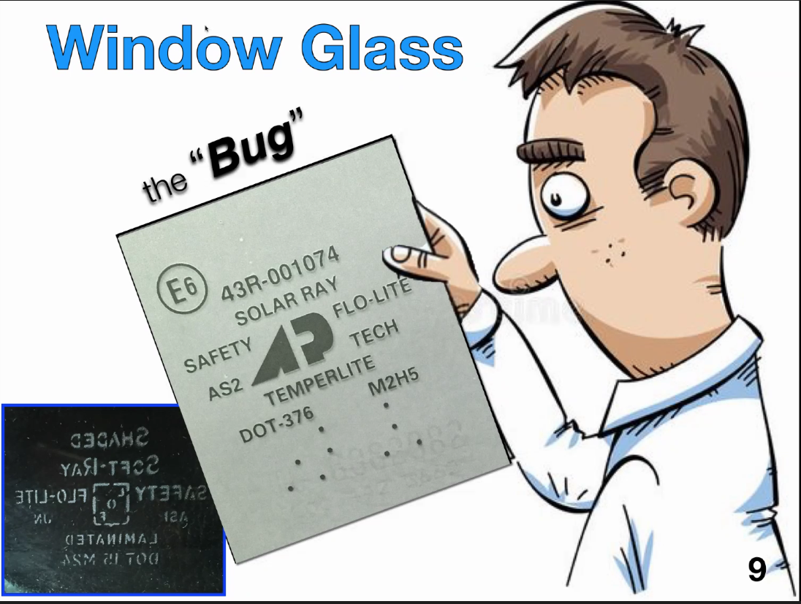
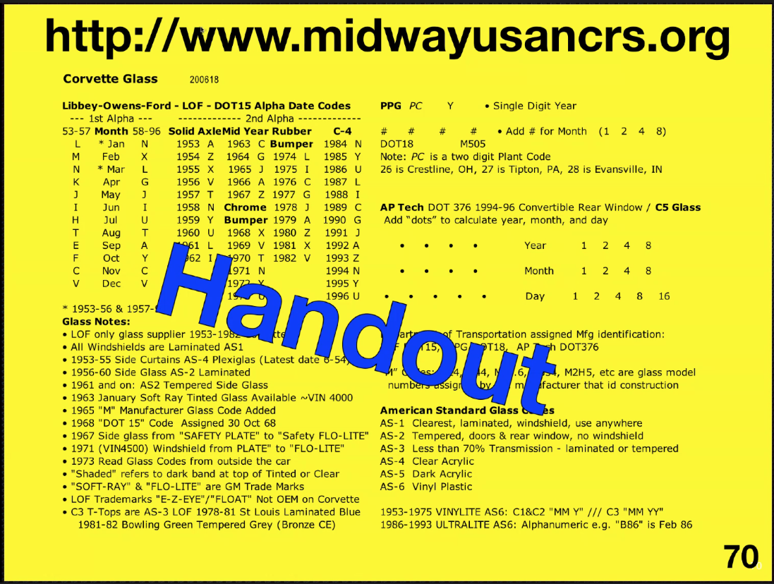

Slide 6
Float Glass Process/Automotive Glass Production
https://www.youtube.com/watch?v=ig4G5WbOMLc
https://www.youtube.com/watch?v=K1PW2iSRPas
Pilkington Process Video- Float Glass
Automotive Glass Production Video

Slide 9
American Standard (AS_) Number
The AS number stands for American Standard, And is “AS” (or “American Standard”) followed by a number indicating the position in which the glass may be used, based on its optical quality.
AS1 is the clearest glass (at least 70% light transmission), is laminated, and can be used anywhere in a motor vehicle (typically just the windshield),
AS2 is tempered with at least 70% light transmissions, and can be used anywhere except the windshield
AS3 can be used in certain locations in certain vehicles (and can be laminated or tempered, and has less than 70% light transmission).
There are higher numbers used for other purposes, but are not normally encountered in cars. This number must be near the manufacturer’s name/logo, preferably below it (Next Slide).

Slide 10
M NUmber
The M number is a model number for the piece of glass, which identifies the type of construction. The M number is unique to the manufacturer, so one an M number of M312 by one manufacturer could be different than glass labeled as M312 by another manufacturer. It identifies the glass construction, including the color and thickness. An M number may be used by multiple part numbers.

Slide 11
DOT
The DOT code (DOT number) is the letters “DOT” followed by a number that the Department of Transportation (National Highway Traffic Safety Administration) assigns to the manufacturer of the glass. This is required by FMVSS205 section S6.2.

Slide 12
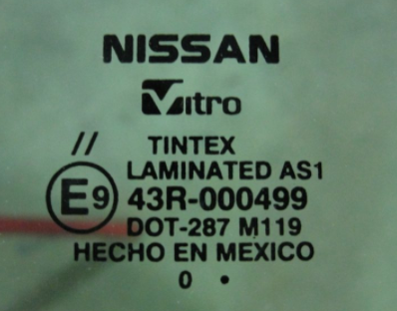
E Code
The E code (with a capital ‘E’) is used for cars in European countries, and indicates the country that certified the windshield. It is a circle with the capital letter E followed by a number. The codes are assigned by the United Nations Economic Commission for Europe.

