Slide 1
NCRS
Operations Judging
Bob Grauer
11-03-2017

Slide 2
Disclaimer
Included tips and comments regarding NCRS operational judging (or the judging process in particular) are based on my own 20+ years experience judging Corvettes as a member of the NCRS. All questions or specific issues should be appropriately addressed to the proper authority, including Chapter Judging Chairpersons, Team Leaders and the National Judging Chairman. My comments may/may not reflect their opinions and are meant to guide and assist development of your judging technique and experiences only.
        Bob G

Slide 3
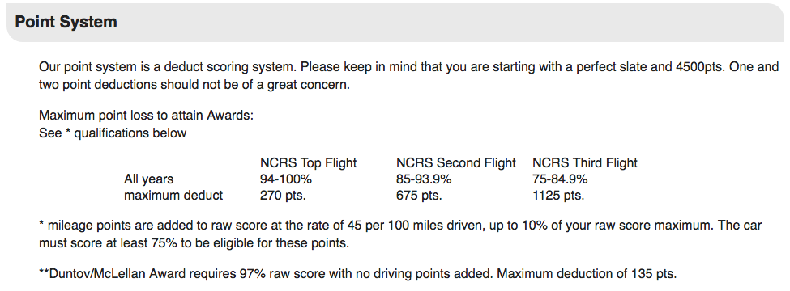
NCRS Flight Judging
Team leader note: 10 points are obtained with the battery cut off, NCRS decal, and fire extinguisher. A small percentage of cars need these points for the Top Flight award, however approximately 20% of the cars being judged for the chief engineer award need these 10 points at one of their judging events to obtain the award. Hill Award in addition to Duntov/McLellan as above 97% raw. (A. Tremain)

Slide 4
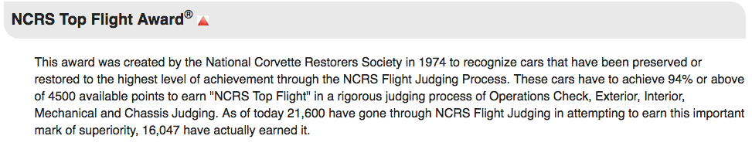
NCRS OPS Judging

Slide 5
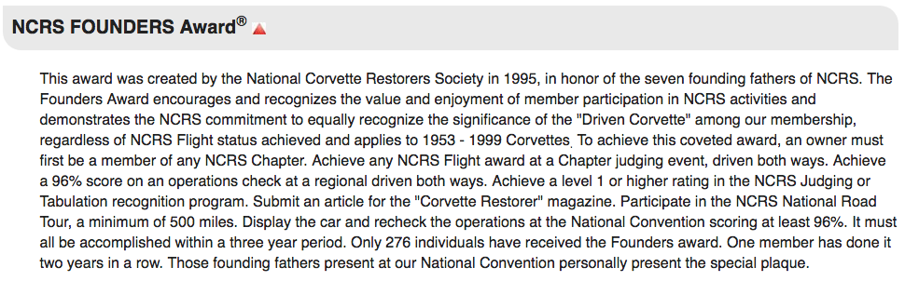
NCRS OPS Judging
Team leader note: Founder Operations does not have the same requirements as Flight Operations. For example a quartz clock receives full credit. (A. Tremain)

Slide 6
NCRS Flight Judging
Cars are to be judged to the standard of vehicle appearance and as equipped at the time and point of final assembly by the Chevrolet Motor Division of General Motors Corporation. “Presentation for judging is to be in the condition normally associated with that of a Corvette which has undergone the then-current standard Chevrolet Dealer New Car Preparation for delivery to a purchaser, exclusive of any dealer or purchaser inspired additions, deletions or changes”

Slide 7
NCRS Flight Ops Judging
NCRS Corvette Technical Information Manual and Judging Guides state:
  The Operations Section of judging does not cover the scope of those items in an NCRS Performance Verification (PV) test; however, all items listed must function and perform as designed, intended and expected when new in order to receive no scoring deduction.
  Partial deductions may be made for faulty or incomplete function.

Slide 8
NCRS Flight Judging
Interpretation:
  “the condition normally associated with that of a Corvette which has undergone the then-current standard Chevrolet Dealer New Car Preparation for delivery to a purchaser”
  Operations Testing- Line items should work as designed for new car delivery to the customer. Not partially, not occasionally, etc…however (dilemma alert!) partial deductions for faulty or incomplete operations are allowed for Flight only.
  Judges should not allow compassion to override the judgment necessary to complete a thorough evaluation of the vehicle.
  No originality or condition matrix components. Performance-Functionality only.

Slide 9
Flight – Scoring Line Point Values
1953-1955 20 points/line item(s)
1956-1957 20 points/line item(s)
1958-1962 20 points/line item(s)
1963-1967 25 points/line item(s)
1968-1972 25 points/line item(s)
1973-1977 25 points/line item(s)
1978-1982 25 points/line item(s)
1984-1986 20 points/line item(s)
1987-1989 20 points/line item(s)
1990-1991 20 points/line item(s)
1992-1993 20 points/line item(s)
1994-1996 20 points/line item(s)
1997-1999 20 points/line item(s)

Slide 10
OPS Flight Judging versus Performance Verification
Performance Verification (PV) is a more rigorous test of the vehicle’s total functionality and as described “new car delivery” condition.
  PV is more comprehensive. All line items are individual components. Not grouped. PV is a comprehensive test.
  A single PV line item failure fails the entire test.
  Flight Judging- No test. Each item scored independent of others.
  PV- One malfunction correction allowed.
  Flight- No malfunction correction allowed.
  PV- Road test. Flight-No road test.
  PV- Precise Preparation of the line item function “as engineered” is required to pass.
  Flight- Line item is judged to “performance acceptable” criteria.
  Flight-Partial deductions for faulty or incomplete operations are allowed.

Slide 11
Performance-Functionality Guidelines
(Flight Ops only)
Deduction Range
  Dealer Prep Performance, New 0% deduct (easy)
  Minor to Severe deviation from expected dealer prep performance-functionality - judges must conference.
  Dilemma facing the judging team: Not a PV test, however must conform to new dealer prep. But…by how much?
  Judging team must ascertain how much deviation exists from the dealer prep expectation versus the vehicle as presented for flight ops judging.
  Minor to severe deviation should be managed in % increments for the specific component part for final deduction from the scoring line.

Slide 12
Performance-Functionality Examples
63-67 #3: Headlights High and Low Beam
  There are 4 functioning components. 25 points total.
  One is out. Three function as expected. ¾ = 75%
  25 @ .75 = 18.75 points.
  Score: 25-19 (rounded up) = 6 point deduction on scoring sheet.
63-67 #17: Kick Panel Vents and Exhaust Vent
  There are either 2 functioning components or 3 depending on year.
  “Sticks - not a smooth operation" is ok for operations and no deduction may be warranted. If the vent can not be completely opened or completely closed is a basis for a partial deduction.
  25 points total.
  Assume 3- Kick Panels (2) “stick-not a smooth operation and do not open/close completely” and exhaust vent (1) is present and operates as expected. One KP is severe, one minor.
  25/3 = 8.333 points each. 8.333 @ .75 = 6.25, 8.333 @ .25=2.08
  Total 8.333 + 2.08 + 6.25 = 16.66
  Score 25 - 17 (rounded up) = 8 point deduction on scoring sheet.
Some are tricky as you can see but it is our responsibility to judge fairly and consistent with the standard.

Slide 13
Performance-Functionality Example
63-67 #27: Seats: Adjustment, Back latching,
  There are 4 functioning components. 25 points total.
  Seat adjustment sticks moderately and does not allow for full adjustment. Back latches function as at time of dealer prep.
  25/4 = 6.25 points each, 12.5 points @ .50 = 6.25 points
  6.25 X 2 = 13 plus 6.25 = 18.25 points
  Total 25 - 18.25 points (round up to 19 score) = 6 point deduction on scoring sheet

Slide 14
Performance-Functionality Example
58-62 #35: Doors and Trunk latching and locking
  There are 6 functioning components to inspect. 20 points total.
  Trunk does not lock.
  20/6 = 3.33 points each. 5 X 3.33 = 16.65 points. One component fails = 3.33 points
  Score: 20-17 (rounded up) = 3 point deduction on scoring sheet.
68-72 #13: Headlight, Park Brake, Door Ajar, Seat Belt Warning
  There are 4 functioning components. 25 points total.
  Two are non-functioning. Two function as expected.
  25 @ .50 = 12.5 points.
  25-13 (rounded up) = 12 point deduction on scoring sheet.
Some are tricky as you can see but it is our responsibility to judge fairly and against the standard.

Slide 15
Safe Practices - All years
Prior to engine start check;
  Fire Extinguisher Present
  Battery Disconnect Switch
  NCRS decal
Not mandatory. Not required for Operations Judging.
Recommendation: Fire Extinguisher should be present for safety reasons though there is no judging requirement for the owner to have one present.
Flight- No repair or adjustments during test.
Note: 10 points awarded for all three present. These points credited independent of operations judging section.

Slide 16
Deductions
Full deductions signed off by appropriate Team Leader
Partial deductions allowed:
  Multiple items on line (examples)
    Gauge Operation, fuel, amp, temp, oil (53-55);
    Brake Light and Back-up Light (63-67);
    Heater, Defroster, and A.C. Operations (63-67);
    Interior Lights: Courtesy (2), rear compartment, glove box (68-72)
    Etc…
Partial credit standard for the operating line item is “low”.
Remember- judges may make partial deductions “for faulty or incomplete operations”

Slide 17
Fast & Slow Idle Deductions
Engine must be COLD for choke and/or fast and slow idle judging.
Should the logistics of an event make cold engines impossible, the Event Judging Chairman may delete choke operation/fast idle judging and owners will not receive a deduction on that item.
82 and newer cars do not have a choke. Fast and Slow idle does apply.
  The following slides assume that the Event Judging Chairperson has not provided this exemption.

Slide 18
Choke Deductions
Choke Function (53-62)
Choke: fast and Slow idle (63-67)
Choke, fast and slow idle. (68-72) TCS (Temp Controlled Spark) or CEC (Combined Emission Control) and 1972 anti-dieseling solenoid.
Check for COLD engine (73-99)
1967 and prior- Choke that falls on 2nd or 3rd cam. Low idle only (per engine specification usually 500-800rpm) fails “choke function line item”.
Mechanical and electric (12v heating element) chokes (53-72), if functioning properly, will always result in a cam-adjusted fast idle if the engine is not at normal operating temperature. Heat tube or wiring current executes normal operation of the spring “unwinding” (expansion) process.
No car should be judged for operations if the engine is already at/near normal operating temperature when Ops judging commences. Ambient temperature should not affect fast and slow idle operations. This is the owners responsibility alone.

Slide 19
Choke Deductions
Bi-Metallic (dissimilar metal) coils of the Bendix type, properly adjusted, begin to open at approximately 75 degrees F (fast idle conditions-enriched fuel/air mixture). These coils as designed will not reach full open until approximately 170 degrees F (low idle conditions-lean fuel/air mixture).
It is not proper for a carburetor, with a properly adjusted choke, to perform at low idle simply due to ambient temperatures < 100 degrees F.
With an electric choke, there is little, if any, probability that the carburetor would perform at low idle due to any ambient temperature variable.
Engine operating temp must be above 120 degrees F for the choke cam to operate off Fast Idle and allow kick-down of the linkage (choke spring partially open)
Bi-Metallic (electric or not) are designed to open “slowly” or at a designed pace.
Direct heat can uncoil the spring a bit – (Arizona sun with hood open) but not to a low rpm idle out of the box.
Bottom line – Don’t fall for the “It’s too hot today for my choke to work” excuse. Take the proper deduction and advise the team leader.

Slide 20
Correction
Some Scoring Sheets state “Mark factory delete with n/a”. If a car does not have an option listed on the score sheet place a slash in the scoring box.
Any options deleted or added from what the car had when it left the factory calls for a full deduction. Dealer installed options are a full deduction.
Always give full credit value (no deduction - a slash) to a factory deleted component. Mark n/a in the comments section only. Do not write n/a in the scoring box on the scoring sheet.
Any component deleted after dealer preparation is deducted for performance/functionality accordingly.
Separate CD or tape radio aftermarket installations are not a deduction if the factory installed radio is fully functional and operates as required in the judging manual.
Not typical gauges are do not call for a deduction if they function as the factory gauges. Additional non typical gauges do not call for a deduction (ex oil temp on early cars).

Slide 21
Owner inspired additions
Components that have been added or altered due to owner inspiration and affect the performance or functionality of the line item component result in a failure deduction of the component.
Ex. Clocks with quartz movement
Aftermarket air conditioning systems added where none existed at dealer preparation.
CD or tape radio systems non-evident/available at dealer preparation
Non-Typical gauges to monitor vehicle performance

Slide 22
Converted Exhaust
Owners that have non-factory side exhaust added (not factory installed) do not automatically receive a deduction for operations judging unless the sound of the exhaust (too loud or inconsistent with dealer prep performance) is identified. Cars without mufflers do not automatically receive a deduction. A deduction is warranted for the sound that deviates from what the sound was as shipped from the factory.
This is based on information provided by a National Team Leader when the question of non-factory installed side pipe PV disqualification came up.
Consult with Exterior and Chassis teams regarding all non-factory installed N14 equipped vehicles. Special attention to the exhaust “note” (1965-67 #19, 1969 #19/#20) is recommended. An appropriate deduction for non-typical exhaust note under these circumstances is advised.

Slide 23
Options
Dealer installed options are a full deduction.
Separate CD or tape radio aftermarket installations are not a deductions if the factory installed radio is fully functional and operates as required in the judging manual.
Not typical gauges do not call for a deduction if they function as the factory gauges.
Additional non typical gauges do not call for a deduction (ex oil temp on early cars).

Slide 24
Safe Ops & Etiquette
Do everything in your power to not damage the vehicle that you are judging.
Safety is paramount when judging operations. The vehicle will be running. It is your team’s responsibility to determine if the vehicle and its owner can operate the vehicle in a safe manner. If you have any concerns, voice them to the team leader before proceeding.
Check thoroughly for any leaks, especially fuel before beginning the Operations Judging process. Fuel leak of any type will STOP judging process. Seek instruction from Team Leader and Judging Chairpersons immediately.
Confirm a proper fire extinguisher is at the ready. A proper fire extinguisher has an “ABC” rating: A-paper, cloth, B- liquid, C- electrical components.

Slide 25
Safety Ops and Etiquette
Do not stand (or let bystanders stand) directly in front or rear of the vehicle during engine start.
Do not allow any other judging team, team leader (me), or owner underneath the car during operations judging. Even if the engine is not running! Your team is in charge!
Battery will be connected during Ops judging. Frayed wiring, sparking/grounding of any component will STOP test. (Same as a fuel leak)

Slide 26
Etiquette
It is reasonable for a judge to enter the vehicle’s driver/passenger compartment to inspect operational components.
Ask permission from owner to enter.
Remove all sharp objects, magnets, mirrors, etc… from pockets prior to entering.
Never use seat cushions for anything except what they are - a seat. It is not a writing table or a “hand/elbow/knee” support.
All functions must be completed by the owner or NCRS approved owner-assigned representative.
Operations Judges do not use keys to open locks, work vents on the passenger side of vehicle, open/close doors, depress cigar lighters, release parking brakes, etc…
Judges work most effectively when they work together, ie…front/rear, Driver/Passenger.

Slide 27
Etiquette
Vehicles with engines running must be carefully monitored. Follow closely the scoring sheet instruction to STOP engine at the appropriate time. Do not allow engine to run excessively.
Scoring sheet components may be reviewed in any order the judges deem acceptable provided the line item grouping of engine ON and engine OFF status items are not mixed.
Cover fenders as necessary
Use blanket or car cover to shade light for better interior light inspection
At completion of judging, each judge signs scoring sheet.
Review full deducts with team leader.
Review findings with owner.
Owner signs
Scoring sheets to Team Leader for log and tabulation

Slide 28
Lastly
Judges - Be patient.
Judges and owners - Fewer cars at meet judging events sometimes requires operations judging to be delayed for safety reasons.
Take your time
Be fair and objective.
Most importantly – Follow NCRS protocols and keep everyone safe.

Slide 29
Thanks!

